Slide 1
Thesis Proposal
Software Engineering
G. S. Varma

Slide 2


Slide 3
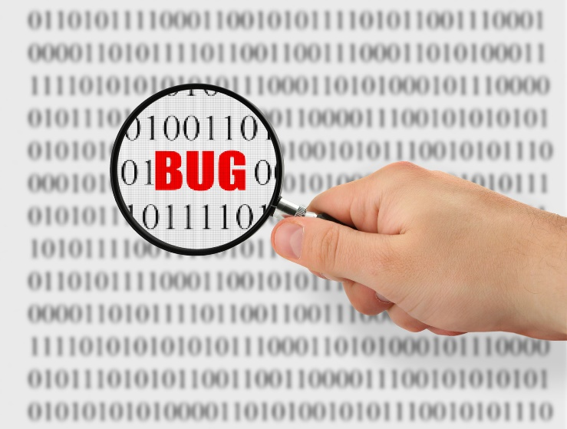
“ $1.1 Trillion in Assets Affected by Software Bugs in 2016 “
Software Fail Watch Annual Report,
Tricentis

Slide 4
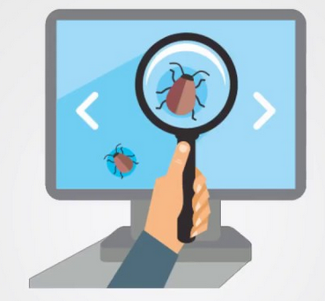
Static Code Analysis
It helps in prevention of bugs.
It examines code without execution.
Detects Vulnerabilities :
- Injections
- Cross Site Scripting (XSS)
- Buffer Overflow, and Dead Code etc

Slide 5
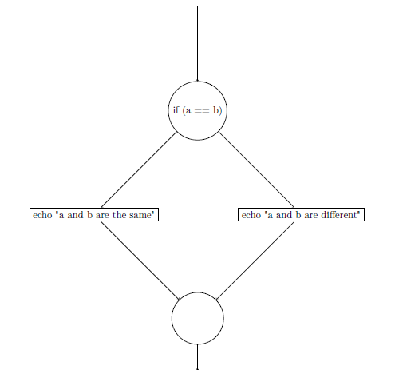
Static Code Analysis
There are different techniques followed for analysing source code.
Example: Data Flow Analysis
Source code Basic blocks
$a = 0;
$b = 1;
If ($a == $b)
{ # start of block
echo "a and b are the same";
} # end of block
else { # start of block
echo "a and b are different";
} # end of block

Slide 6


Static Code Analysis
Tools :
IDE Notifications,
IDE tools,
Dedicated tools,
Linters
CLI tools.

Slide 7
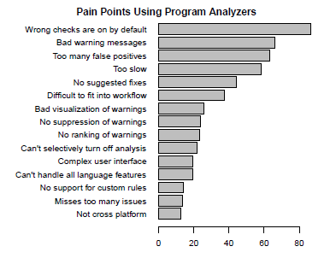
Research Papers:
- Maria et. al.
Johnson et. al.
Found: developers facing issues in using tools
Most importantly, USABILITY issue.

Slide 8

SARIF
Static Analysis Results Interchange Format (SARIF)
Standard representation of bug warnings in a JSON format

Slide 9
Multiple Tools
Developers seem to use multiple static analysis tools each having own coverage.
Research trends:
Using multiple static analysis tools in order to prioritise the bug warning alerts
Using results of three different static analysis tools for a programming language, Java and merges them together in order to show warnings to the developer
But USABILITY is not addressed…

Slide 10
Multiple Tools
SARIF scope - different analysis tools results can be integarted
Need for addressing Usability issue

Slide 11

“You can't connect the dots looking forward;
you can only connect them looking backwards.
So you have to trust that the dots will somehow connect in your future.”
― Steve Jobs

Slide 12
Thesis Topic
Integration of Multiple Static Analysis Tools
in a Single Interface

Slide 13
Thesis Work Plan
Problem Statement
Research Questions
What Current Tools do?
Our Approaches
Evaluation
Time Plan

Slide 14
Problem Statement
How to integrate the results of multiple static analysis tools
in a unified user interface?

Slide 15
Research Questions
How to display results of the same codebase from different analysis tools?
What feedback works to know that the bug fixing is on-going?
How to carry traceability of bug fixing?

Slide 16
Thesis Work Plan
Problem Statement
Research Questions
What Current Tools do?
Our Approaches
Evaluation
Time Plan

Slide 17
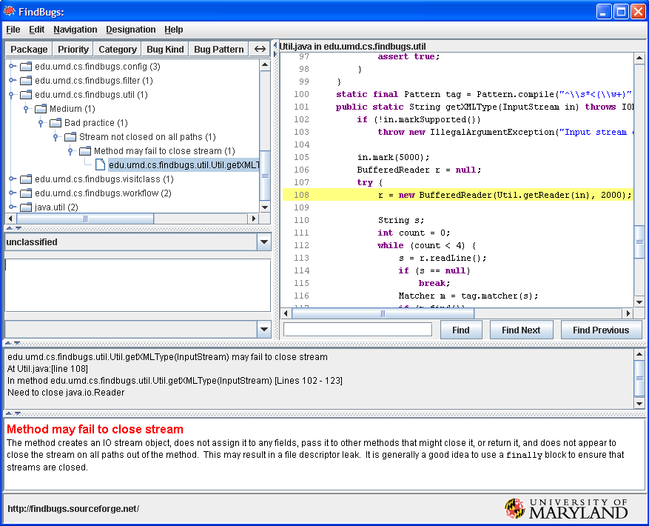
What Current Tools do? - RQ 1
FindBugs

Slide 18
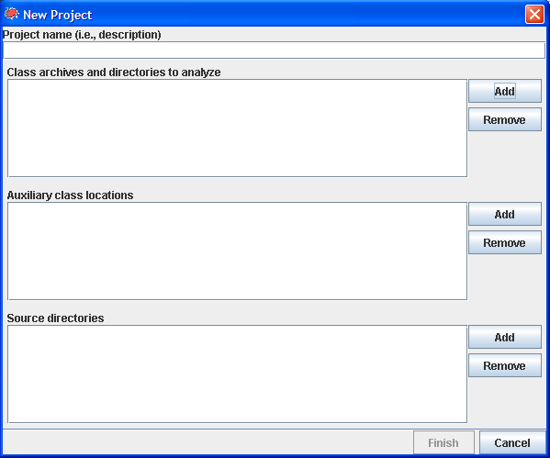
What Current Tools do? - RQ 2
FindBugs

Slide 19
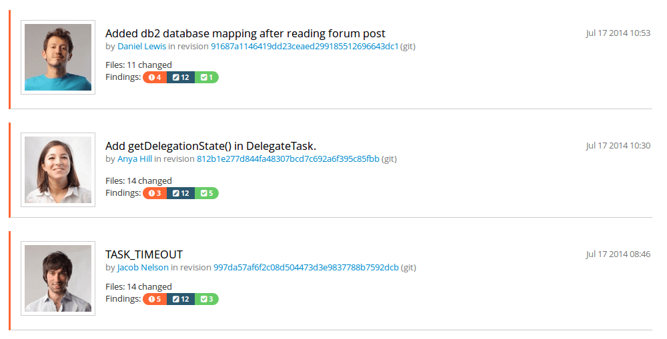
What Current Tools do? - RQ 3
TeamScale

Slide 20
Thesis Work Plan
Problem Statement
Research Questions
What Current Tools do?
Our Approaches
Evaluation
Time Plan

Slide 21
Our Approaches
Research different techniques that tackle the respective research question in other domains of software engineering.
Adapt those techniques and design own techniques for the domain of static analysis.
Design prototypes with a wireframe tool of those techniques to improve the usability of integrating analysis tools.
Design user studies that evaluate the efficiency of those techniques, with professional code developers.
Run the user studies and report on their results.
Loop 2 to 5

Slide 22
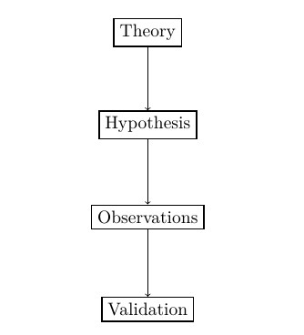
Our Approaches
Research Methodology - Deductive inference
Software Engineering disciplines:
Complex datasets
Compiler reporting
Continuous integration
Refactoring tools
Issue tracker
Stack Overflow
Gamification
Usability Engineering

Slide 23

Our Approaches
Complex datasets:
Dix et. al. - more complex grouping and linking of datasets in the context of a user interface of Spreadsheets application.
Design lesson : extensibility of columns
Gaur et. al. - linear search problem in indexing as it takes more time for large volumes of data. So, different parameters are introduced to decrease computation time.
Example: Searching for toy

Slide 24
Our Approaches
Compiler reporting
Horning et. al
error logging with statistics
stating what kind of bugs are not found along with bugs found

Slide 25
Our Approaches
Refactoring tools
Dustinca
- barrier of discoverability
introduced a smart tag for code can be refactored.
'on-board' phase _ Gamification
Hayashi et. al. - task level commits in order to maintain edit history

Slide 26
Our Approaches
Issue tracker
Baysal et. al. :
Information overload
Expressiveness
Ideal to describe the priory as per team decision instead of personal choice.

Slide 27
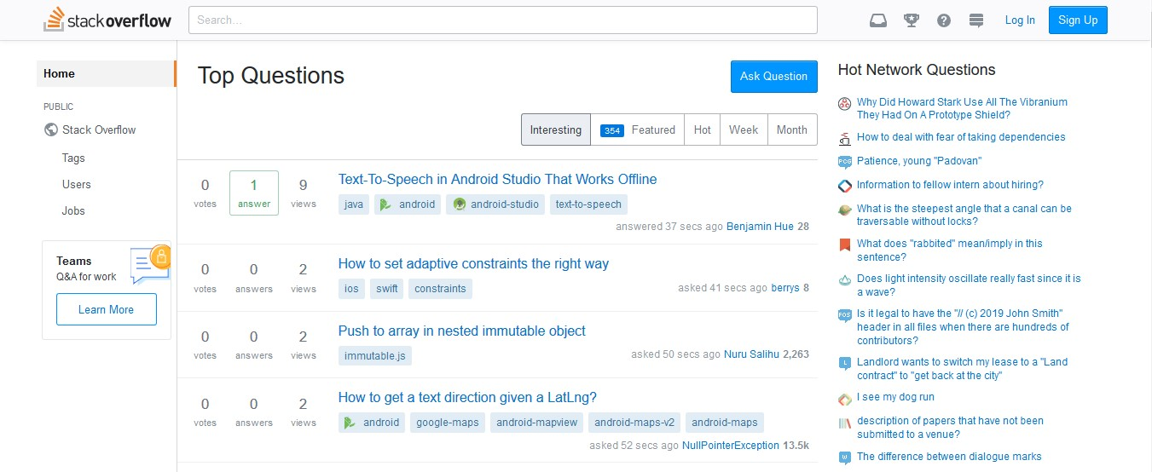
Our Approaches
Stack Overflow
- Wang et. al. : 10934198 questions on a 'User Interface' topic
- Treude et. al. : 72.30 % questions have between 2 and 4 tags

Slide 28
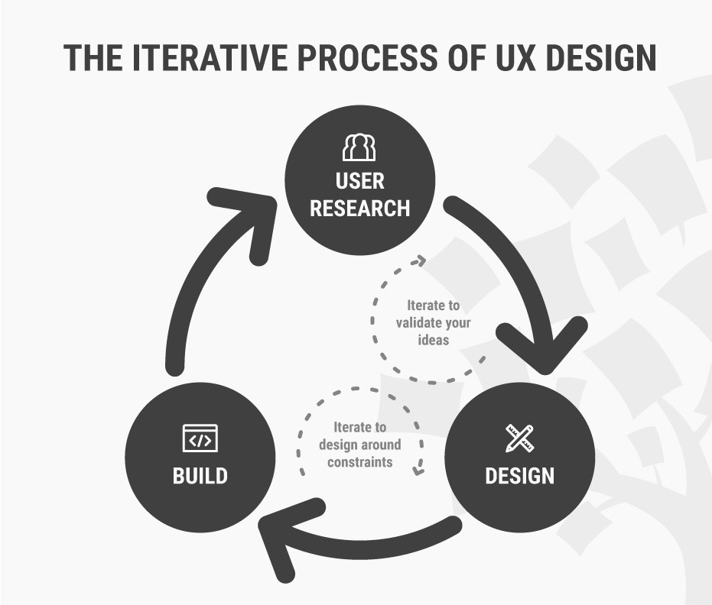
UX Design Cycle

Slide 29
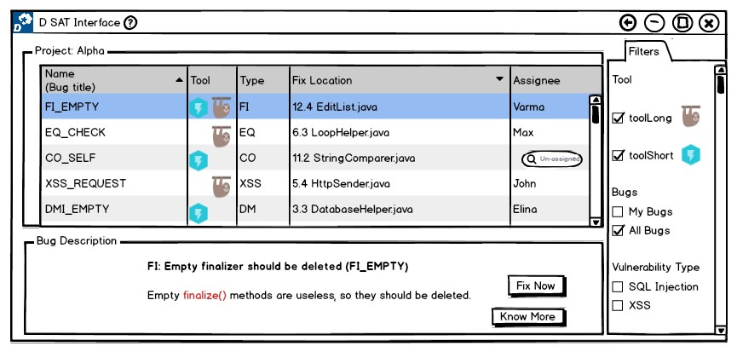
Example: RQ 1
Prototype 1

Slide 30
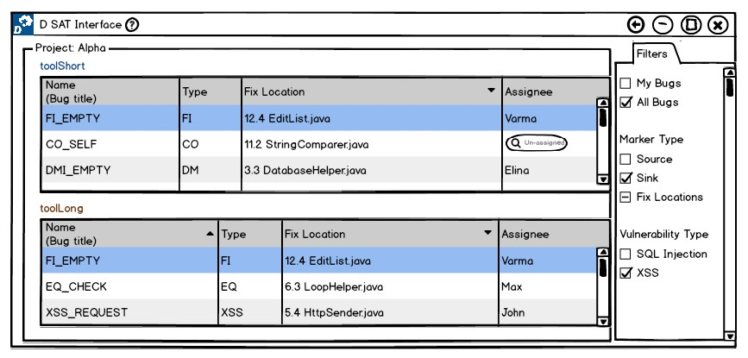
Example: RQ 1
Prototype 2

Slide 31
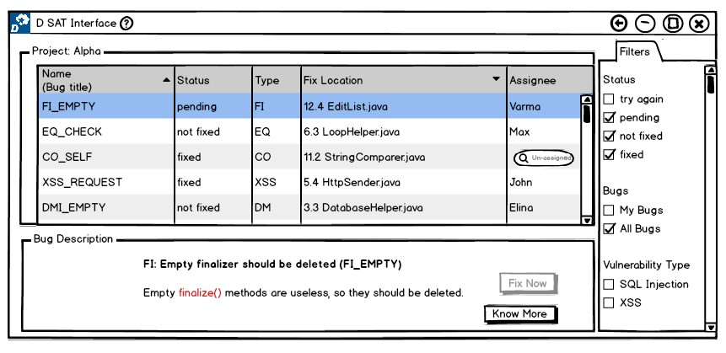
Example: RQ 2
Prototype 1

Slide 32
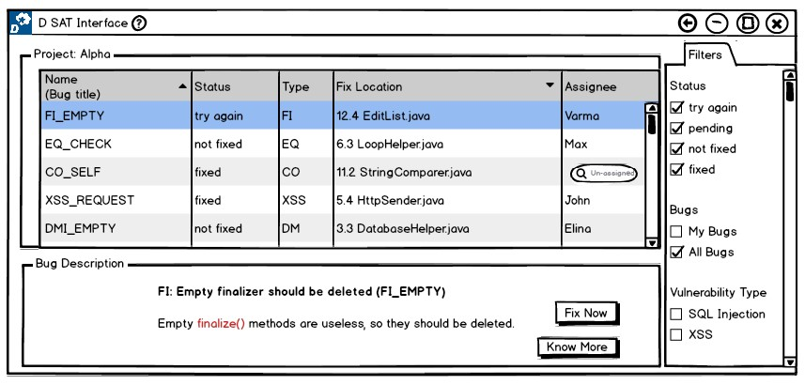
Example: RQ 2
Prototype 2

Slide 33
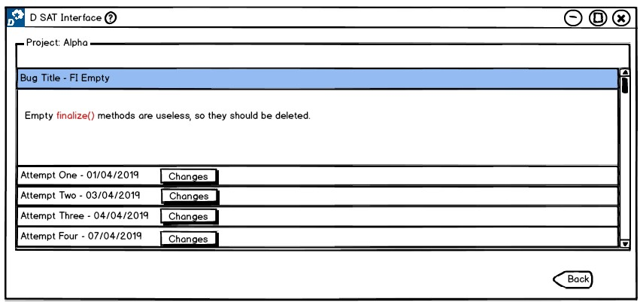
Example: RQ 3
Prototype 1

Slide 34
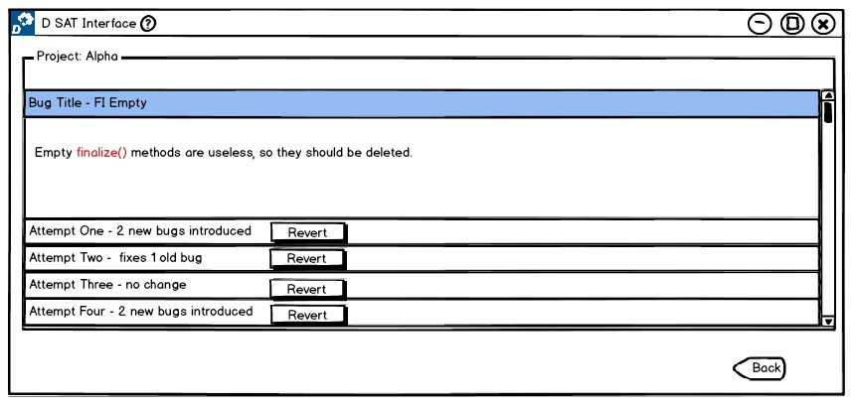
Example: RQ 3
Prototype 2

Slide 35
Thesis Work Plan
Problem Statement
Research Questions
What Current Tools do?
Our Approaches
Evaluation
Time Plan

Slide 36
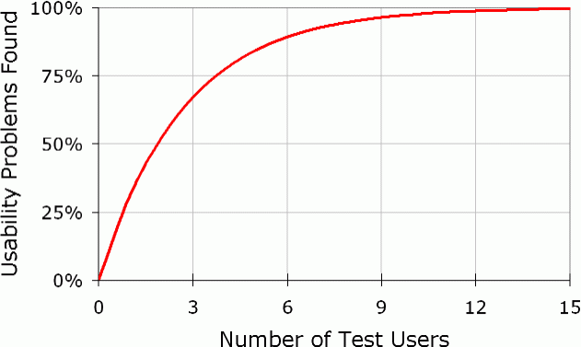
Evaluation
Experimental Design
Number of Test Users:
Dr. Nielsen recommends - 5
Order of evaluation:
Users tend to learn – order of presenting prototyes is altered

Slide 37
Evaluation – Usability Inspection Methods
Cognitive Walkthrough
For each step to a predefined task, the following aspects are analysed.
Will the user try and achieve the right outcome?
Will the user notice that the correct action is available to them?
Will the user associate the correct action with the outcome they expect to achieve?
If the correct action is performed; will the user see that progress is being made towards their intended outcome?

Slide 38
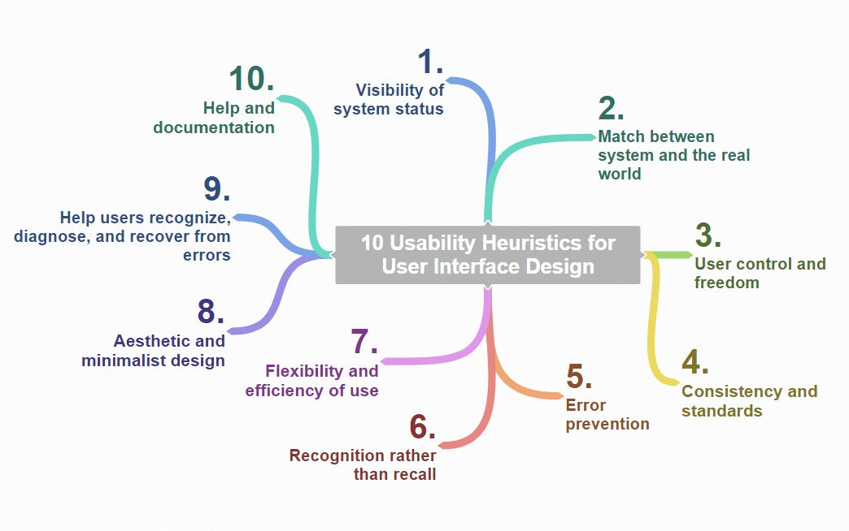
Evaluation – Usability Inspection Methods
Heuristic Evaluation

Slide 39
Evaluation – Usability Inspection Methods
Heuristic Evaluation
Each problem w.r.t. a heuristic is rated accordingly; 0 – 4
0 - do not agree this is a usability problem
1 - cosmetic problem
2 - minor usability problem
3 - major usability problem ( important to fix )
4 - usability catastrophe ( imperative to fix )

Slide 40
Thesis Work Plan
Problem Statement
Research Questions
What Current Tools do?
Our Approaches
Evaluation
Time Plan

Slide 41
Time Plan
Official Time Frame : 5 Months [ May – September ]
4 Milestones, Each Month with weekly tasks
UX Design Cycle Iteration 1
UX Design Cycle Iteration 2
UX Design Cycle Iteration 3
Thesis Documentation

Slide 42
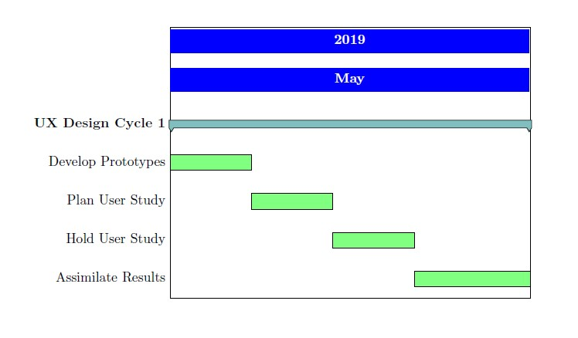
Milestone 1

Slide 43
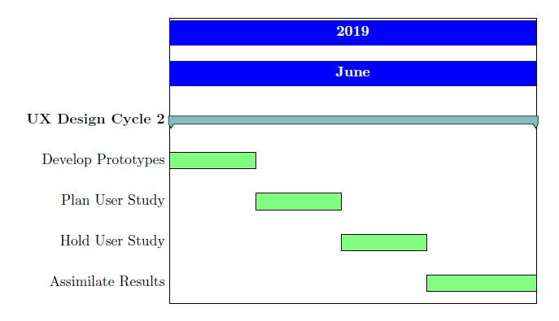
Milestone 2

Slide 44
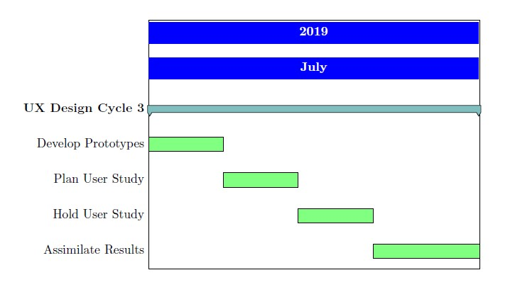
Milestone 3

Slide 45
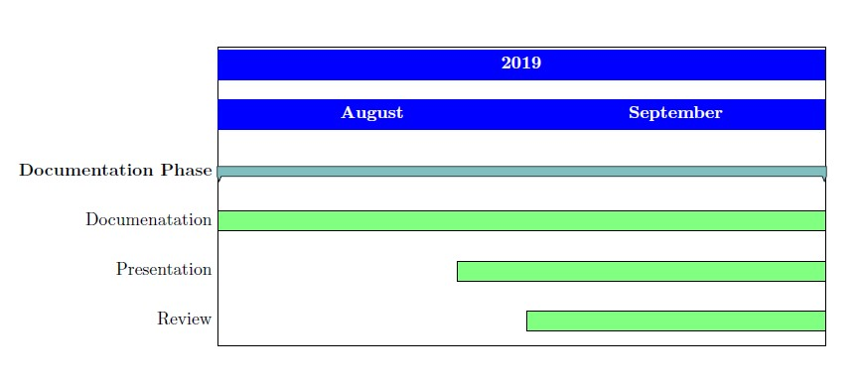
Milestone 4

Slide 46
References
[1] A Survey of Static Program Analysis Techniques. url: https://www.ics.uci.edu/ ~lopes/teaching/inf212W12/readings/Woegerer-progr-analysis.pdf
[2] Balsamiq. Rapid, effective and fun wireframing software. | Balsamiq. url: https : / /balsamiq.com/.
[3] Olga Baysal, Reid Holmes, and Michael W. Godfrey. “No issue left behind: reducing information overload in issue tracking”. In: Proceedings of the 22nd ACM SIGSOFT International
Symposium on Foundations of Software Engineering - FSE 2014. Ed. by Shing-Chi Cheung, Alessandro Orso, and Margaret-Anne Storey. New York, New York, USA: ACM
Press, 2014, pp. 666–677. isbn: 9781450330565. doi: 10.1145/2635868.2635887.
[4] Al Bessey et al. “A few billion lines of code later: using static analysis to find bugs in the real world”. In: Communications of the ACM 53.2 (2010), pp. 66–75.
[5] Marilyn Hughes Blackmon et al. “Cognitive walkthrough for the web”. In: Proceedings of the SIGCHI conference on human factors in computing systems. ACM. 2002, pp. 463–470.
[6] Lorraine Borman. Proceedings of the SIGCHI Conference on Human Factors in Computing Systems. New York, NY: ACM, 1985. isbn: 0897911490. url: http://dl.acm.org/
citation.cfm?id=317456.
[7] Checkmarx – Application Security Testing and Static Code Analysis. url: https://www. checkmarx.com/.
[8] Maria Christakis and Christian Bird. “What developers want and need from program analysis: an empirical study”. In: Automated Software Engineering (ASE), 2016 31st
IEEE/ACM International Conference. IEEE. 2016, pp. 332–343.
[9] John David Colleran, Gerardo Bermudez, and Vadim Gorokhovky. Responsive user interface to manage a non-responsive application. US Patent 6,850,257. Feb. 2005.
[10] Aurelien Delaitre et al. “Evaluating Bug Finders–Test and Measurement of Static Code Analyzers”. In: 2015 IEEE/ACM 1st International Workshop on Complex Faults and Failures
in Large Software Systems (COUFLESS). IEEE. 2015, pp. 14–20.
[11] Designing code analyses for Large Software Systems (DECA). url: https://www.hni.uni-paderborn.de/swt/lehre/deca/.
[12] Alan Dix et al. “Spreadsheets as User Interfaces”. In: Proceedings of the International Working Conference on Advanced Visual Interfaces - AVI ’16. Ed. by Maria Francesca
Costabile et al. New York, New York, USA: ACM Press, 2016, pp. 192–195. isbn: 9781450341318. doi: 10.1145/2909132.2909271.
[13] dustinca. Proceedings of the 2nd Workshop on Refactoring Tools. New York, NY: ACM, 2008. isbn: 9781605583396. url: http://dl.acm.org/citation.cfm?id=1636642.

Slide 47
References
[14] FindBugsTM - Find Bugs in Java Programs. url: http://findbugs.sourceforge.net/.
[15] FindBugsTM - GUI Scan Results. url: http://findbugs.sourceforge.net/manual/gui.html.
[16] Lori Flynn et al. “Prioritizing alerts from multiple static analysis tools, using classification models”. In: Proceedings of the 1st international workshop on software qualities and their
dependencies. ACM. 2018, pp. 13–20.
[17] Gamification | Coursera. url: https://www.coursera.org/learn/gamification.
[18] Garima Gaur, Sumit Kalra, and Arnab Bhattacharya. “Patterns for Indexing Large Datasets”. In: Proceedings of the 23rd European Conference on Pattern Languages of Programs - EuroPLoP18. Ed. by Unknown. New York, New York, USA: ACM Press, 2018, pp. 1–6. isbn: 9781450363877. doi: 10.1145/3282308.3282314.
[19] Shinpei Hayashi et al. “Historef: A tool for edit history refactoring”. In: 2015 IEEE 22nd International Conference on Software Analysis, Evolution, and Reengineering (SANER).
IEEE, 2/03/2015 - 06/03/2015, pp. 469–473. isbn: 978-1-4799-8469-5. doi: 10 . 1109 / SANER.2015.7081858.
[20] Lars Heinemann, Benjamin Hummel, and Daniela Steidl. “Teamscale: Software quality control in real-time”. In: Companion Proceedings of the 36th International Conference on
Software Engineering. ACM. 2014, pp. 592–595.
[21] James J Horning. “What the compiler should tell the user”. In: Compiler Construction. Springer. 1974, pp. 525–548.
[22] How to Change Your Career from Graphic Design to UX Design. url: https://www.interaction-design.org/literature/article/how-to-change-your-career-fromgraphic-
design-to-ux-design.
[23] Brittany Johnson et al. “Why don’t software developers use static analysis tools to find bugs?” In: Proceedings of the 2013 International Conference on Software Engineering.
IEEE Press. 2013, pp. 672–681.
[24] Erica Mealy et al. “Improving Usability of Software Refactoring Tools”. In: 2007 Australian Software Engineering Conference (ASWEC’07). IEEE, 10/04/2007 - 13/04/2007, pp. 307–
318. isbn: 0-7695-2778-7. doi: 10.1109/ASWEC.2007.24.
[25] Na Meng et al. “An approach to merge results of multiple static analysis tools (short paper)”. In: 2008 The eighth international conference on quality software. IEEE. 2008,
pp. 169–174.

Slide 48
References
[26] Lisa Nguyen Quang Do and Eric Bodden. “Gamifying Static Analysis”. In: Proceedings of the 2018 26th ACM Joint Meeting on European Software Engineering Conference and Symposium on the Foundations of Software Engineering. ESEC/FSE 2018. Lake Buena Vista, FL, USA: ACM, 2018, pp. 714–718. isbn: 978-1-4503-5573-5. doi: 10.1145/3236024.
3264830.
[27] Jakob Nielsen. “Usability inspection methods”. In: Conference companion on Human factors in computing systems. ACM. 1994, pp. 413–414.
[28] OASIS. url: https://www.oasis-open.org/.
[29] OASIS SARIF TC. url: https://www.oasis-open.org/committees/tc_home.php?wg_abbrev=sarif.
[30] OASIS SARIF TC: Repository for development of the draft standard. url: https://github.com/oasis-tcs/sarif-spec.
[31] Observe, Test, Iterate, and Learn (Don Norman) (Video). url: https://www.nngroup.com/videos/observe-test-iterate-and-learn-don-norman/.
[32] Daniel Plakosh et al. Improving the Automated Detection and Analysis of Secure Coding Violations. Tech. rep. CARNEGIE-MELLON UNIV PITTSBURGH PA SOFTWARE
ENGINEERING INST, 2014.
[33] Response Time Limits: Article by Jakob Nielsen. url: https : / / www . nngroup . com /articles/response-times-3-important-limits/ (visited on ).
[34] Sample Of Covered Software Vulnerabilities (OWASP Top 10 and more). url: https://www.checkmarx.com/technology/vulnerability-coverage/.
[35] SARIF Example. url: https://blogs.grammatech.com/static-analysis-resultsa-format-and-a-protocol-sarif-sasp.
[36] Software Fail Watch. url: https://www.tricentis.com/news/software-fail-watchsays-1-1-trillion-in-assets-affected-by-software-bugs-in-2016/.
[37] SWAMP SCARF to SARIF. url: https://github.com/mirswamp/swamp-scarf-sarif.
[38] Teamscale. url: https://www.cqse.eu/en/products/teamscale/features/.
[39] The Definition of User Experience (UX). url: https://www.nngroup.com/articles/definition-user-experience/.
[40] Christoph Treude, Ohad Barzilay, and Margaret-Anne Storey. “How do programmers ask and answer questions on the web?” In: Proceeding of the 33rd international conference
on Software engineering - ICSE ’11. Ed. by Richard N. Taylor, Harald Gall, and Nenad Medvidovic. New York, New York, USA: ACM Press, 2011, p. 804. isbn: 9781450304450.
doi: 10.1145/1985793.1985907.

Slide 49
References
[41] Usability 101: Introduction to Usability. url: https://www.nngroup.com/articles/usability-101-introduction-to-usability/.
[42] Usability Engineering : Book by Jakob Nielsen. url: https://www.nngroup.com/books/usability-engineering/.
[43] Shaowei Wang, David Lo, and Lingxiao Jiang. “An empirical study on developer interactions in StackOverflow”. In: Proceedings of the 28th Annual ACM Symposium on Applied
Computing. ACM. 2013, pp. 1019–1024.
[44] Why You Only Need to Test with 5 Users. url: https://www.nngroup.com/articles/why-you-only-need-to-test-with-5-users/.

Slide 50

Thank you for listening...
G. S. Varma

